Slide 1
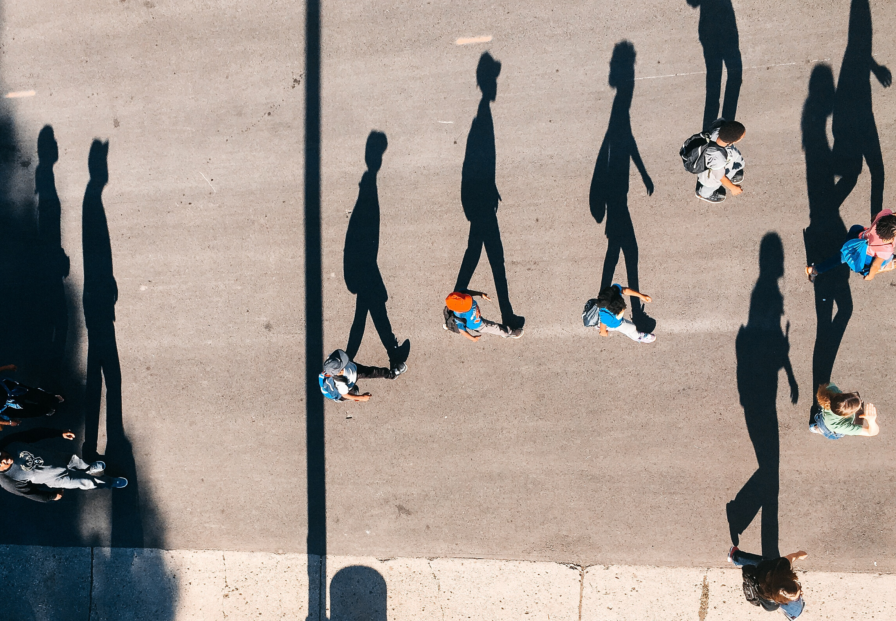
Passion Project (WT)
Creating inclusive social spaces
Alex Brooks
Notes:
- Interesting we're now in a time of social distancing and I'm presenting on this. This issue is now even more important and a great time to reflect on this subject as we take a step back and learn to appreciate the connections we do have as we're forced into social "isolation". Communicating digitally is the new norm and it's time right now and I feel it's time we take a hard look at the way that we interact with each other online.
- What are our values?

Slide 2
INTRODUCTION
Social media as a whole is the new face of the modern day ad industry. Everyday, platforms are in a constant battle for consumer attention as their sole focus is to monetize that attention in a cycle dubbed the "attention economy". But what remains unseen is the impact that the constant bombardment of "content" has had on society, especially to young people. In a world that favors the sources that draw the most attention, we've lost what it means to be authentic in favor of flamboyant personas.
The aim for my project is to create healthier digital spaces. I want to promote meaningful interactions and foster real relationships between people. To find connections without the need for a flood of content, but by trying to find a deeper understanding of an individual using other attributes of their digital footprint.
COME BACK AND SYNTHESIZE THIS

Slide 3
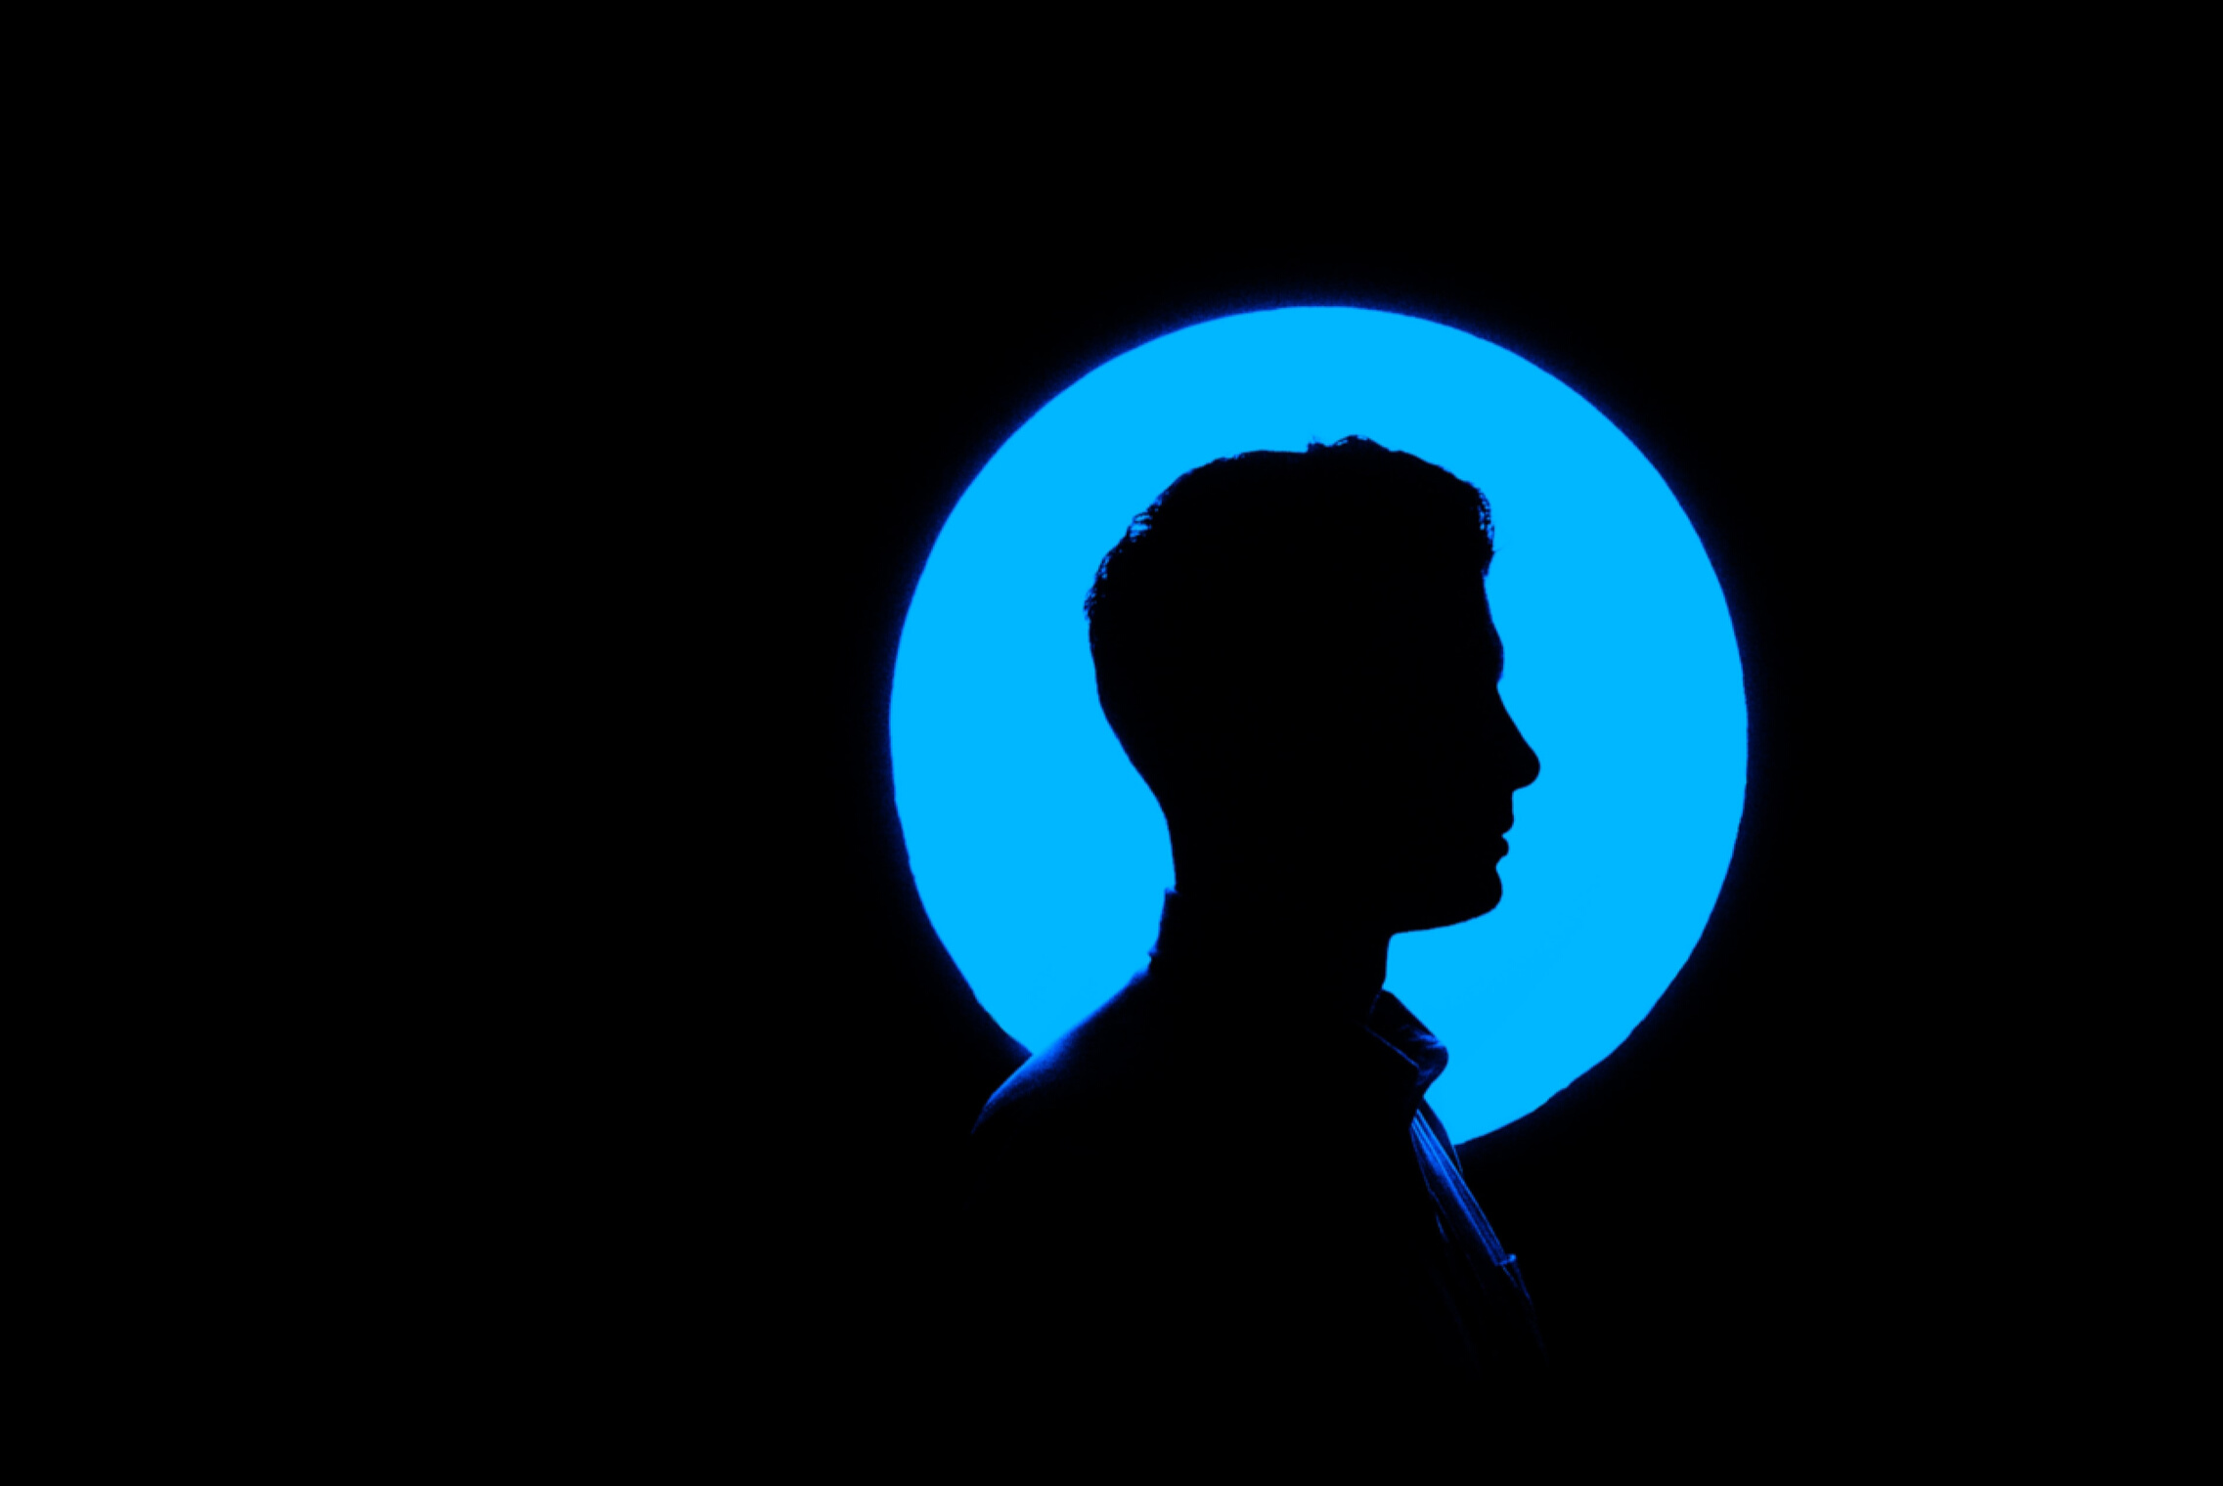
73%
of Gen Z (18-22 year olds), report "sometimes" or "always" feeling alone.
ref: Cigna Corp
Notes:
That's up from 69% the previous year.

Slide 4
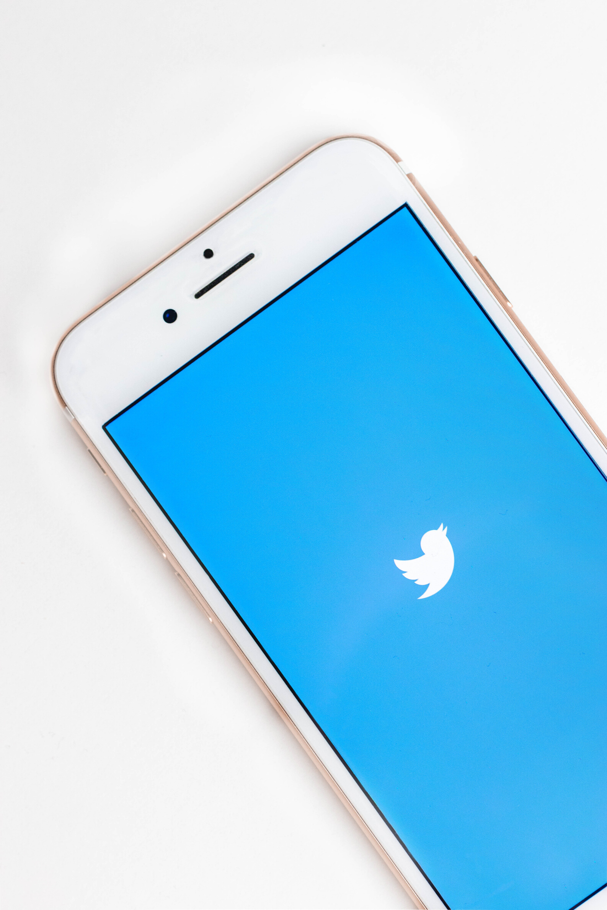
PROBLEM STATEMENT
For this project, I am going to use three different data sources using Twitter and create a features set using NLP, network analysis, and personality classificationn. I will use these features to create a recommender system to connect Twitter users. My main goal is to use only retweets form the account timelinne, tweets that were favorited by the account, annd the accouts the person is following. This is to test the hypothesis that connenctionns can be made between people without havingn to use a catalog of original content.
COME BACK AND SYNTHESIZE THIS
Notes:
Every second, ~6000 Tweets are tweeted on Twitter, which corresponds to over 350,000 tweets sent per minute, 500 million tweets per day, and around 200 billion ntweets per year (via Brandwatch).
^ Work this in there somewhere?

Slide 5

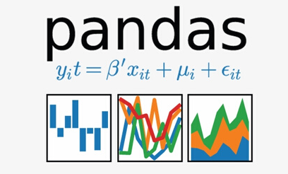
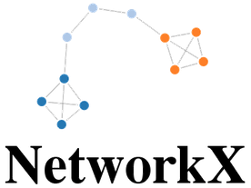



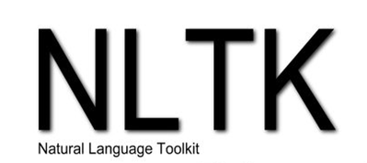


WORKFLOW
Data Wrangling
Data Cleaning &
Text Pre-Processing
Natural Language
Processing Models
Network Modeling
Flask App Development
Presentations are tools that can be used as lectures, speeches, reports, and more.
Presentations are tools that can be used as lectures, speeches, reports, and more.
Presentations are tools that can be used as lectures, speeches, reports, and more.

Slide 6

TOPIC MODELING
<--------------
(UMAP projection of topics)
Presentations are tools that can be used as lectures, speeches, reports, and more. It serves a variety of purposes, making presentations powerful tools for teaching.

Slide 7
FIND YOUR TRIBE.
Link to dashboard/app here.

Slide 8
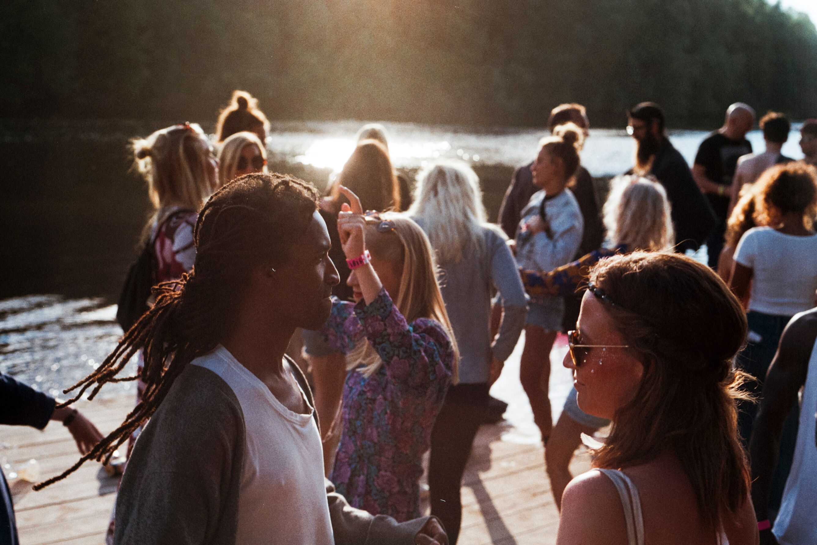

KEY TAKEAWAYS & FUTURE WORK
Key takeaway here
And right here
And right here

Slide 9

Conclusion Slide
Put a quote here, that'd be cool.
— Some cool person

Slide 10





THANK YOU
EMAIL ADDRESS
brooks.alexr@gmail.com
PHONE NUMBER
(757) 561 - 8904

